Slide 1
WELCOME

Slide 2
Blinkit Marketing and Customer Feedback Dashboard
Power BI Dashboard Project
Presented By Gomathi G

Slide 3
Introduction
Blinkit is a leading instant grocery delivery platform that operates in multiple cities, serving thousands of customers daily through digital marketing campaigns and app-based ordering. The company collects large volumes of data related to customers, orders, products, delivery performance, and marketing campaigns.
Blinkit is one of India’s leading quick-commerce (q-commerce) platforms, delivering groceries and daily essentials to customers within minutes.

Slide 4
Problem Statement
Which marketing campaigns generate higher revenue compared to their spending, and which campaigns perform best financially?
How is customer engagement distributed across different channels?
What is the distribution of customer satisfaction levels based on ratings?
How many orders are delivery on time and show delivery status?
Which payment methods are most preferred by customers in which category?
Which cities generate the highest number of orders.

Slide 5
Dataset Overview
Source: Blinkit Marketing and Customer Feedback dataset
Data Table :
  Customer feedback
  Customers
  Marketing Performance
  Order items
  Orders
  Product

Slide 6
Data Transformation
Data Import
Remove Unnecessary Columns
Remove Blank Values
Change Data Types
Create New Columns
Split & Merge Columns
Load Clean Data

Slide 7
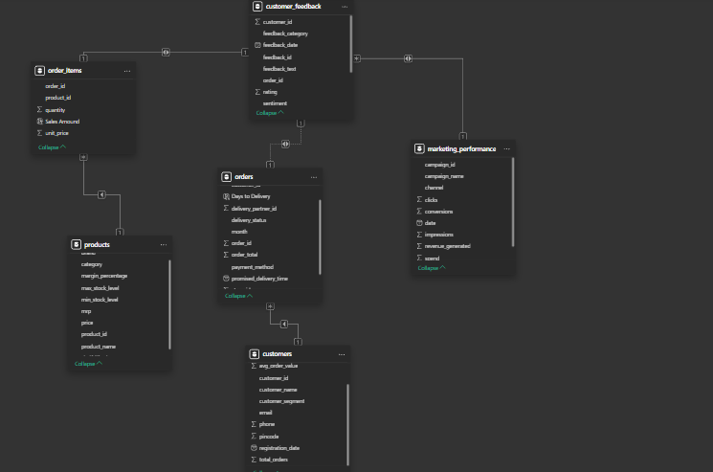
Data Modeling
Snowflake Schema Applied

Slide 8
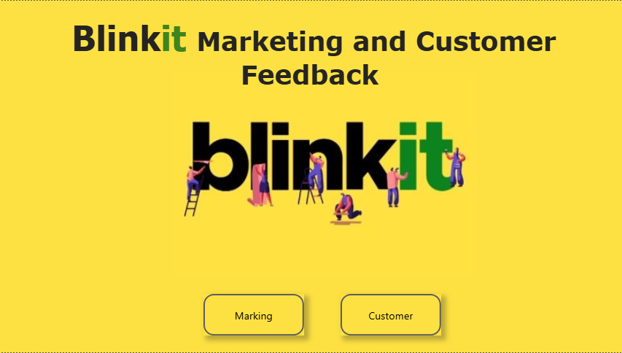
Dashboard

Slide 9
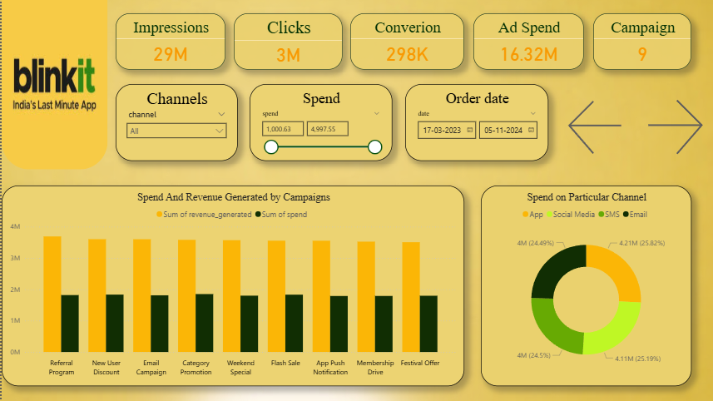

Slide 10
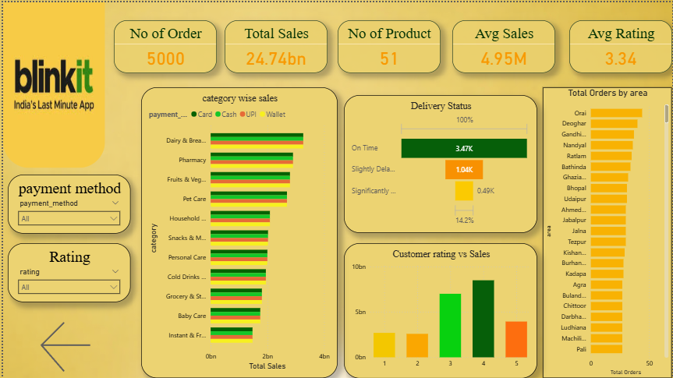

Slide 11


Key KPIs
Marketing
Customer

Slide 12
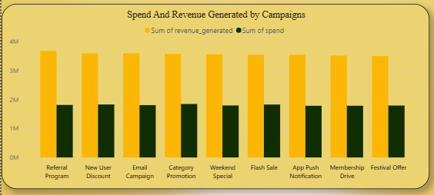
Charts Used
Spend and Revenue Generated by Campaigns
Chart - Clustered Column Chart
X-axis – campaign name
Y-axis – sum of revenue generated,
sum of spend

Slide 13
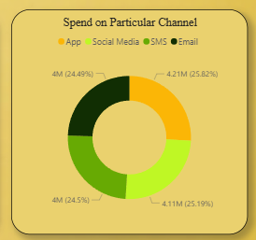
Spend on Particular Channel
Chart - Donut Chart
Legend – Channal
Value – sum of spend

Slide 14
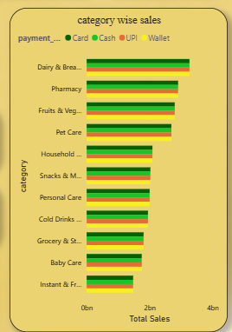
Category wise Sales
Chart - Clustered Bar Chart
Y-axis – Category
X-axis – Total Sales
Legend – Payment method

Slide 15
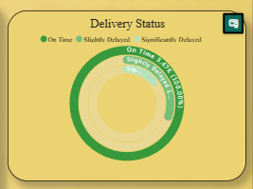
Delivery Status
Chart – Actively Gauge
Category – Delivery Status
Values – Count of Order id

Slide 16
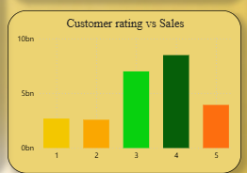
Customer Rating VS Sales
Chart - Stacked Column Chart
X-axis – Rating
Y-axis – Total Sales

Slide 17
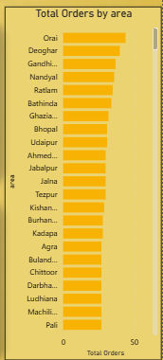
Total Orders By Area
Chart - Clustered bar Chart
X-axis – Area
Y-axis – Total Order

Slide 18
Conclusion
The Blinkit Marketing and Customer dashboard provides a clear view of campaign performance, customer behavior, and sales trends. It highlights which marketing channels generate higher revenue and which customer segments contribute the most to orders. These insights help the business optimize marketing spend and improve customer engagement. Overall, the dashboard supports better data-driven decision-making.

Slide 19
Thank You

